Slide 1
Asia’s Time Bomb
Asia currently has over seven million people infected with HIV, at the rate of 2658 HIV+ cases per day.
If there is no drastic, immediate action taken, Asia will soon follow the steps of Africa, i.e., with an explosive HIV/AIDS epidemic.

Slide 2
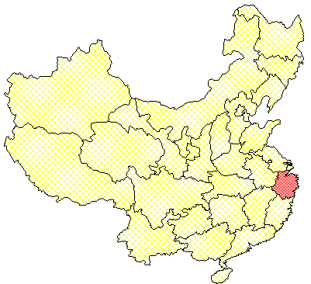
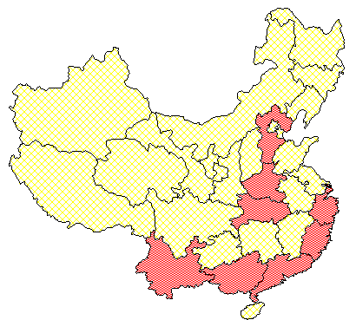
Spread of HIV in Mainland China
In 1985, HIV was first detected in a Chinese National
1985
1989
1985-1989: Sporadic infections appeared in some areas

Slide 3
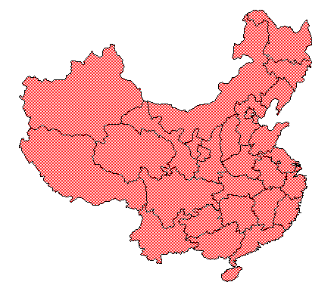
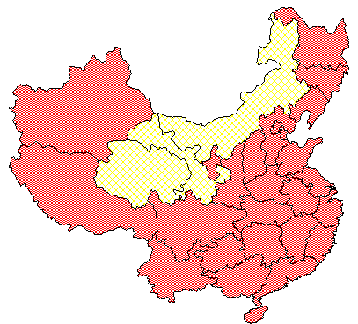
Spread of HIV in Mainland China
Post-1994, the epidemic spread from drug users to other groups in more areas
1998
1995
By 1998, every province had HIV cases reported

Slide 4
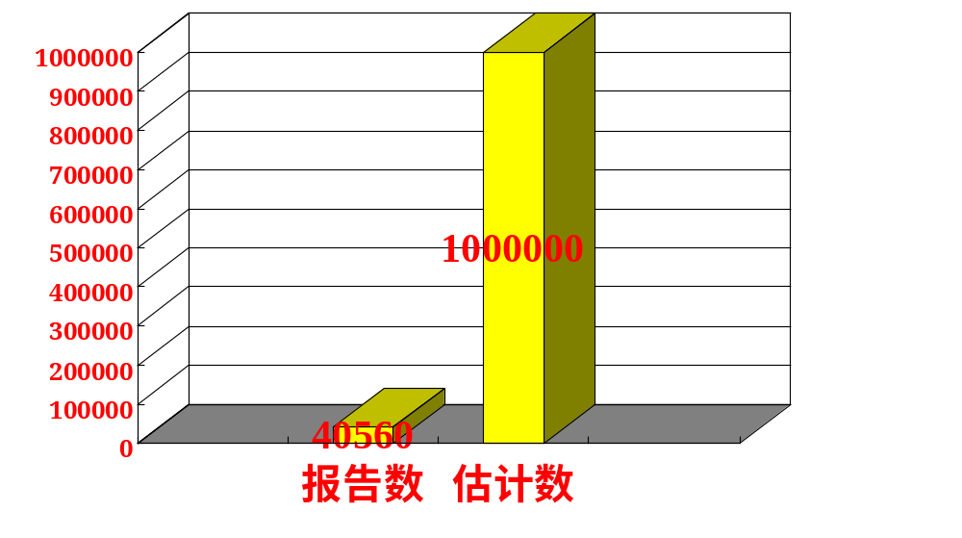
中国HIV/AIDS
累计报告数与估计数(2002)
年龄以青壮年为主，20-29岁年龄组占53.6%
Ministry of Health, China, 2002

Slide 5
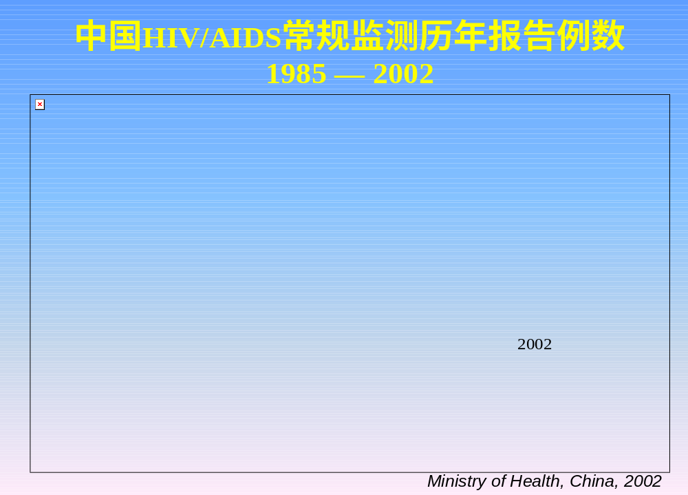
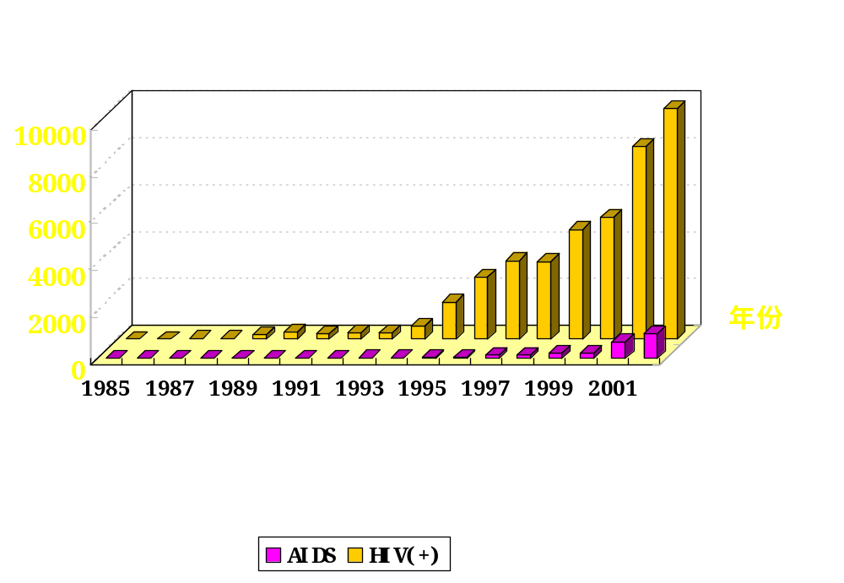

Slide 6
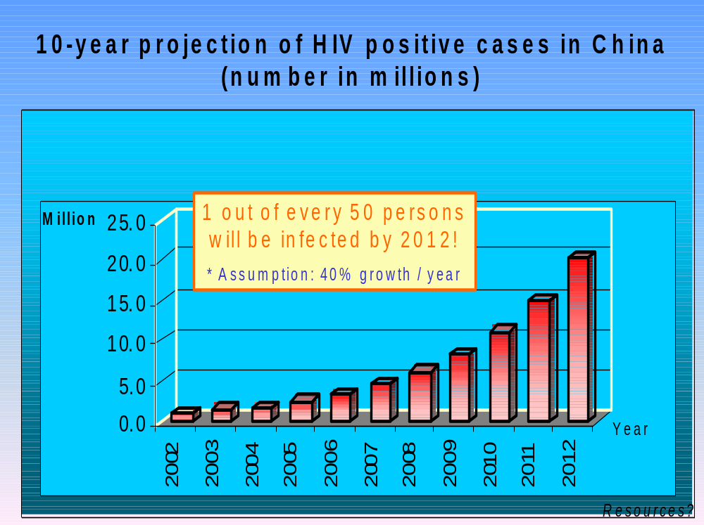

Slide 7
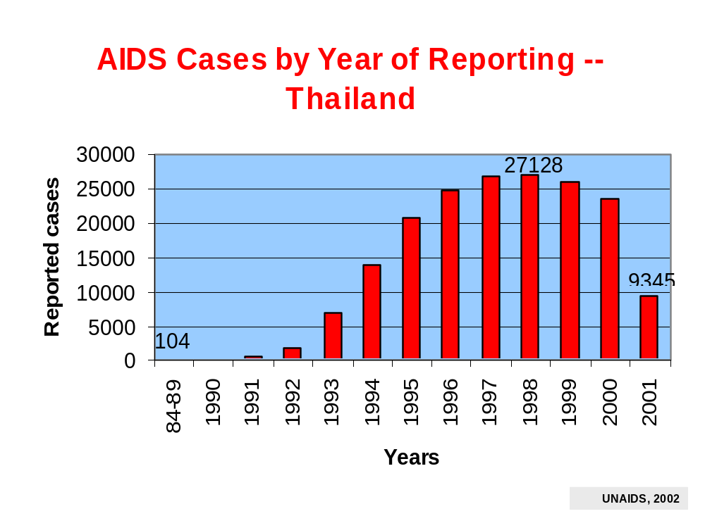

Slide 8
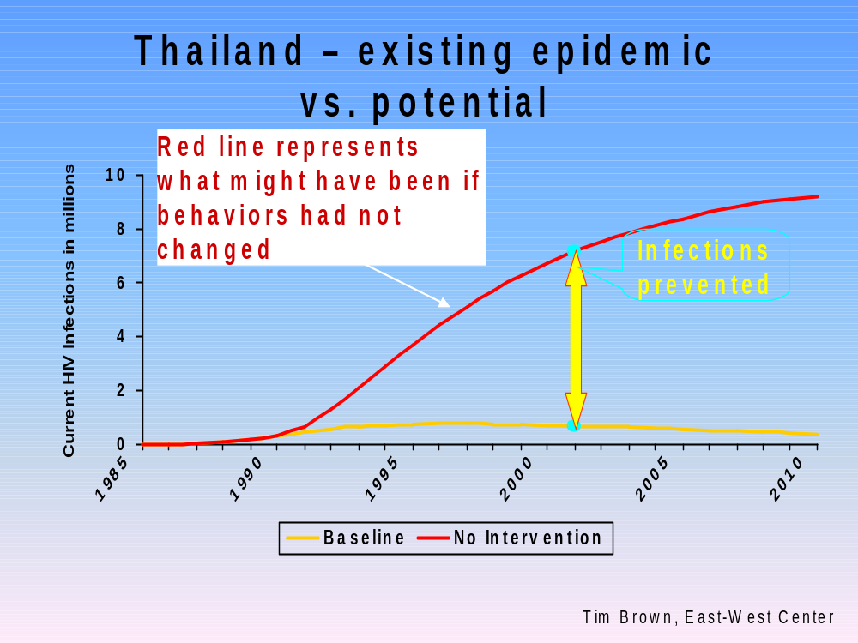

Slide 9
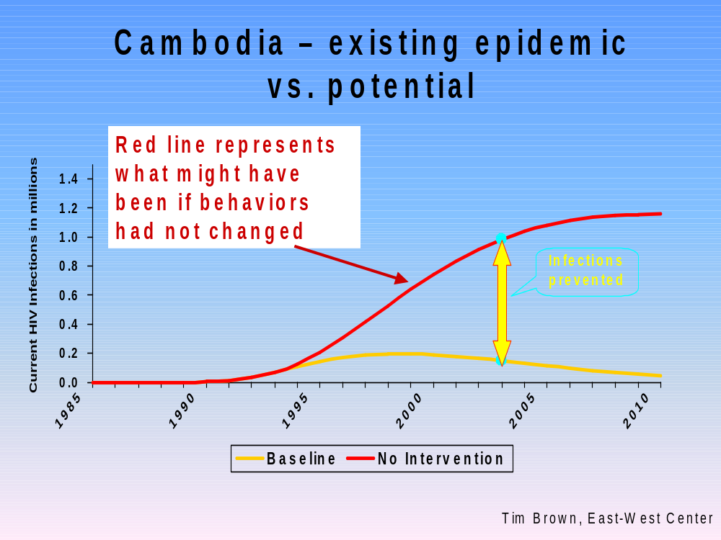

Slide 10
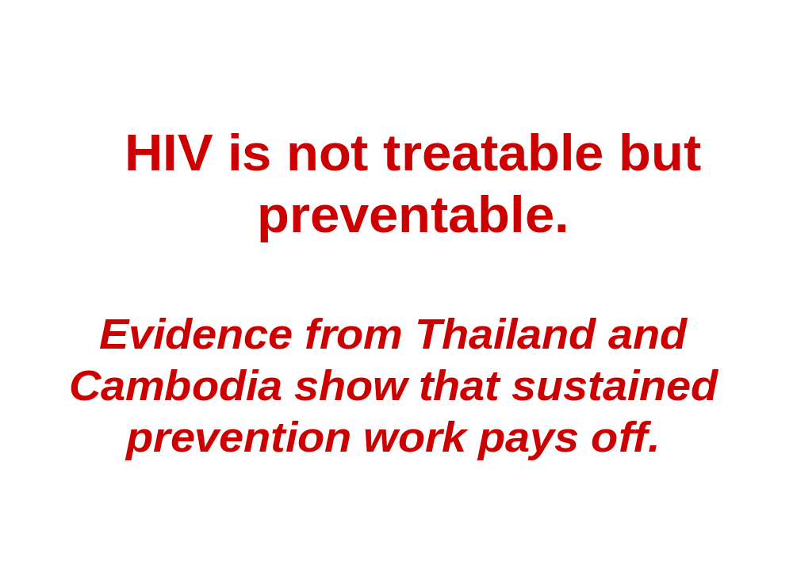

Slide 11
Economic Impact
According to the expert’s estimate, the average medical expense for each HIV patient is 80,000 to 104,000 ¥ (Chinese Yuan). In the next ten years, the social economic loss will reach 2.2 to 4.0 billion ¥
Source - Forum: The impact of AIDS
to the social economic in China, 8/2002

Slide 12
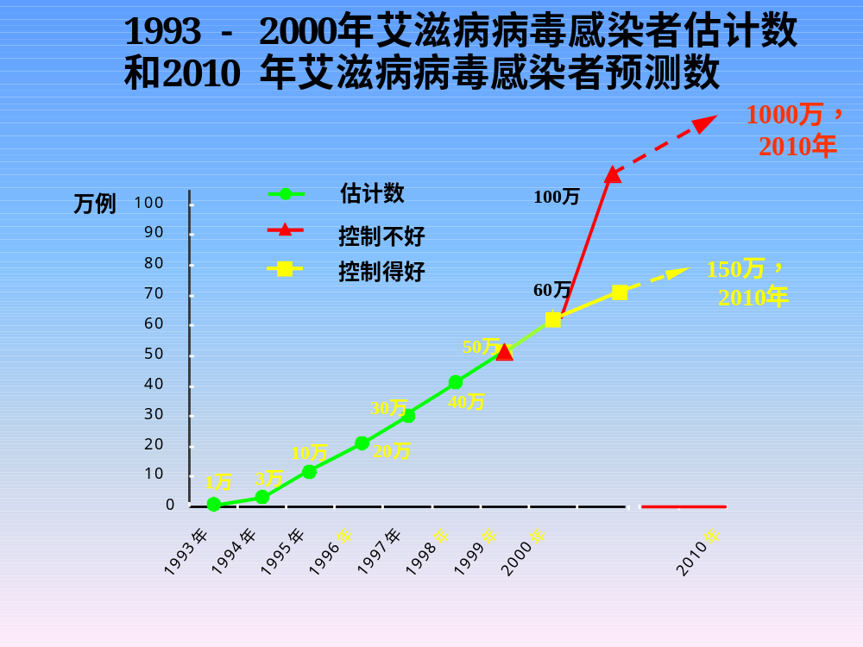

Slide 13
